Slide 1
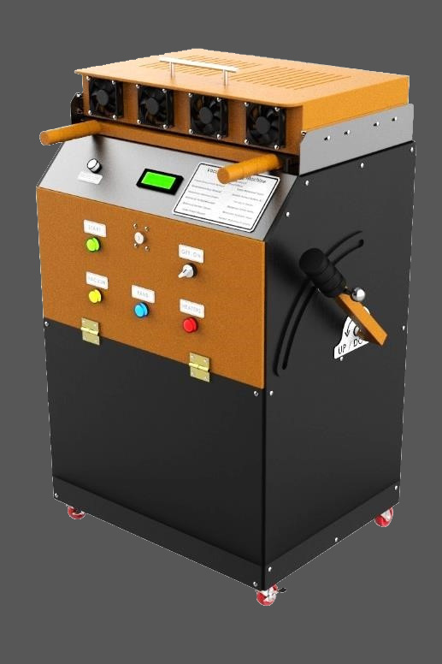

PROJECT 2
DESIGN & MANUFACTURING OF
MANUAL VACUUM FORMING MACHINE
Under the supervision of
Dr. Mahmoud Mohamed Saafan

Slide 2
WHAT IS IT ?
VACUUM FORMING MACHINE
Vacuum forming is a manufacturing method used to shape plastic materials. During the vacuum forming process, a sheet of plastic is heated and then pulled around a single mold using suction.
Vacuum forming is used for a wide range of manufacturing applications, ranging from small custom parts produced on desktop devices to large parts manufactured on automated industrial machinery.

Slide 3
VACUUM FORMING MACHINE
DISCUSSION FLOW
Mechanical Portion
Hardware Portion
Software Portion
Applications

Slide 4

Mechanical Portion
MEET THE TEAM
HASAN MOHAMED HASAN
MOHAMMED FARIED EL-SOFANY
IBRAHIM HAMED IBRAHIM ALI
KARIM KHALED ELSAYED

Slide 5
Mechanical Portion

Slide 6
VACUUM FORMING MACHINE
DISCUSSION FLOW
Mechanical Portion
Hardware Portion
Software Portion
Applications

Slide 7
Hardware Portion
MEET THE TEAM
ABDELRAHMAN MAMDOUH IBRAHIM
HOSSAM AHMED ABD
EL-MAKSOUD
AMR USRY EL-SHERBINY
MOHAMED ABDALLAH HASSAN

Slide 8
Hardware Portion

Slide 9
VACUUM FORMING MACHINE
DISCUSSION FLOW
Mechanical Portion
Hardware Portion
Software Portion
Applications

Slide 10
Software Portion
MEET THE TEAM
ABDELRAHMAN NASR MAAROOF
MAHMOUD ALI ABDALMONEM
MAHMOUD IBRAHIM OSMAN

Slide 11








Software Portion
Programming definition:
All programs need data to be added to or removed from code. Data entered into a program, either by the programmer or digitally, are referred to as inputs. These inputs are stored in variables and used to run the program.
In order to keep the user informed about what is happening inside the program, a programmer may choose to include outputs. This is where the data from the program is shown to the user, either on screen or in the form of a physical output such as printouts or signals.
components
I/P
O/P
Selector (ON\OFF)
Encoder selector
LCD
AC lamps
Buzzer

Slide 12
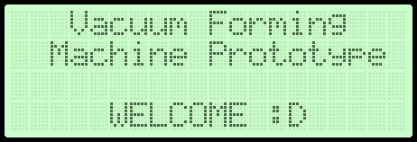
Software Portion
Part(1):
ALGORITHM:
Initialization and Void setup.
Import required libraries.
Assign due pins.
Initialize data variables (Material, Thickness & Temperatures).
Initialize LCD.
Display on LCD WELCOME message.

Slide 13
Software Portion
Part(2):
ALGORITHM:
Void loop Stage(0).
Display on LCD 1st Menu (Select Material).
Read encoder position.
Choose the material (PVC/Acrylic/PP).
Display on LCD 2nd Menu (Select thickness).
Read encoder position.
Choose the material thickness (300 µm / 650 µm / 1 mm).
Display on LCD 3rd Menu (Preview Chosen Data).
Read encoder position.
Choose (Continue or not):
Continue: Proceed to vacuum forming process.
Return: to 1st Menu.

Slide 14
VACUUM FORMING MACHINE
DISCUSSION FLOW
Mechanical Portion
Hardware Portion
Software Portion
Applications

Slide 15
Applications

Slide 16
VACUUM FORMING MACHINE
DISCUSSION FLOW
Mechanical Portion
Hardware Portion
Software Portion
Applications

Slide 17
THANK YOU!

